Slide 1

AUSTRALIA JADA INTERNATIONAL TRADING COMPANY
Innovating.
Collaborating.
Uniting.

Slide 2
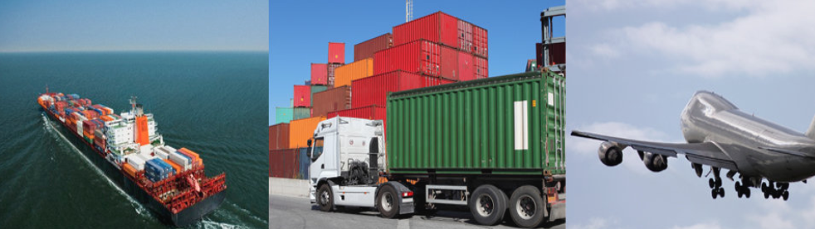
Company Profile
Business Type: Trading Company, Buying Office, Agent
Main Products: Hardware, Tools, Household Products, Iron & Steel Products, Australian Quality Drink & Food Products, Australian Property & Lands, Education Courses
Trade Capacity: 50% Oceania 50% North America
Total Revenue: US$1 Million - US$2.5 Million

Slide 3

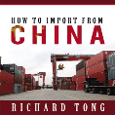
Company Capability
Import From China
Export To China
Hundreds of eBooks
We have strong sourcing team and business partner in China. Our aim is to assist Australian importing companies to source quality Chinese products and supply them from China. We can provide education course & arrange container shipment, quality inspection, etc., all kind of services.
We have office in China to promote and advertise your products to Chinese market. We can provide education course and reach Joint Venture partnership agreement with Australianexporting companies.
Hundreds of High Quality English Version eBooks in this eBookStore for your selection.

Slide 4
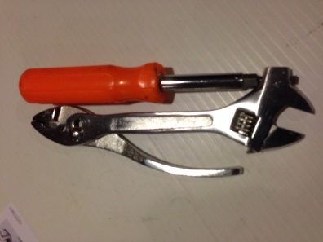
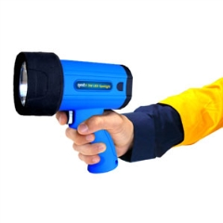
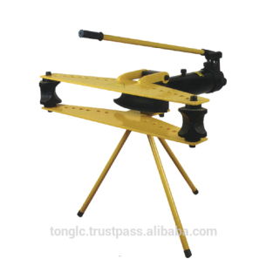

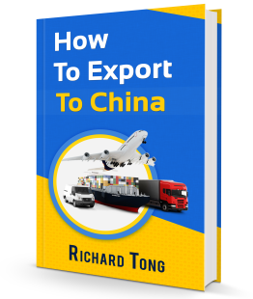
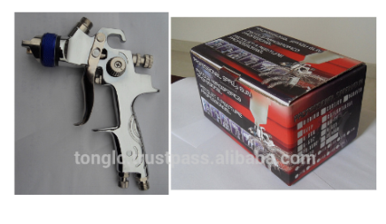

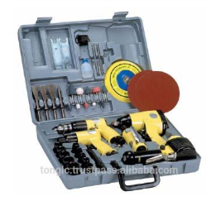
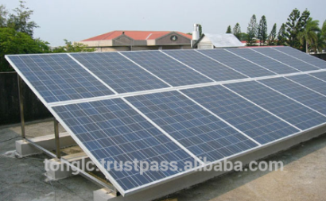
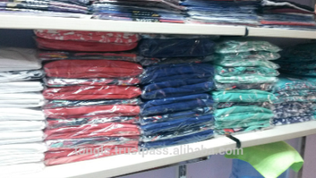
Company Capability
Tools, Households Products, Apparel, E-books, etc.

Slide 5

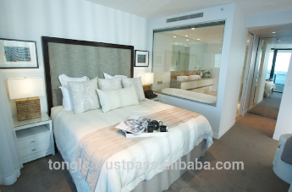

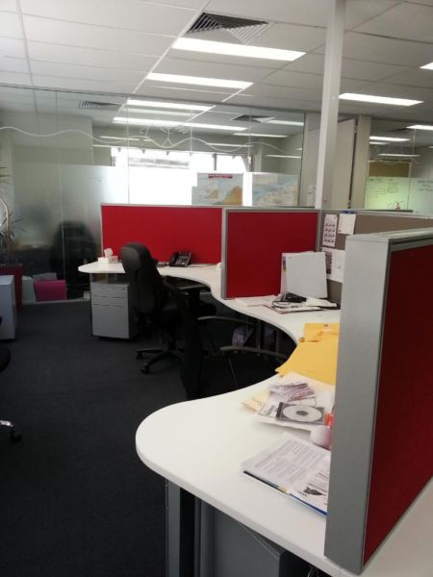


Company Capability
Australian Property & Lands

Slide 6
Get in Touch
Telephone: 61-7-55307658
Mobile Phone: 0403738210
Fax: 61-7-55227109
Mr. Richard Tong
Address: P. O. Box 5231, Robina, zip 4230
State: Queensland
City: Gold Coast
Country: Australia

